Slide 1

Methods
Lecturer
Rokas Slaboševičius
Data

Slide 2
Today you will learn
Methods
Methods
01

Slide 3
What are methods?
Methods
Methods are blocks of code that are designed to perform a specific function. They can be reused in the code of a programme and can accept parameters and return a result. Methods in C# are very useful for organising and modularising code, thus helping to facilitate the development and maintenance of a program.

Slide 4

What are methods?
Methods
The syntax of the methods is quite simple. Here is a general example of the structure of methods:
The access_modifier specifies the access level of the methods and can be public, private, protected, internal, protected internal or private protected. public means that the method can be accessed from anywhere in the application, while private means that it is only accessible from within the same class.
return_type specifies the type of result returned. If the method returns nothing, the void keyword is used.
method_name is the unique name of the methods.
parameter_list is a list of variables that the method accepts as parameters. Each parameter has a type and a name.

Slide 5
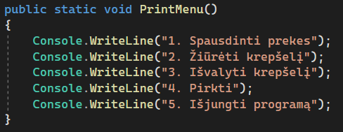
What are methods?
Methods
Let's try to create a simple method that does not return anything, such methods are designed to perform some action without reporting the result of the action.
Let's analyse:
The method is public, which means it will be available
from "outside" what in C# would be accessible from other
classes.
The return type of the method is void, which means that the method will not return any variables after the action.
The name of the method is PrintMenu(), so you will need to call it accordingly.
There are no parameters specified between the () brackets, which means that no variables need to be passed when calling the PrintMenu() method

Slide 6
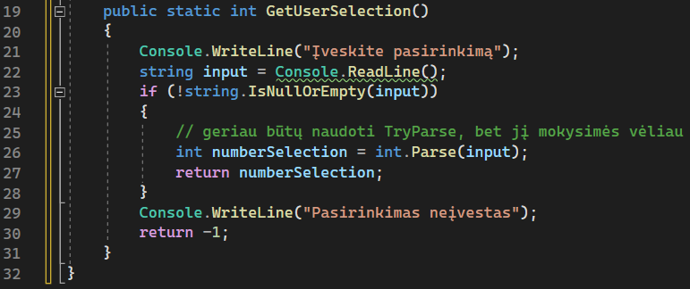
What are methods?
Methods
Now let's look at the method that returns the result.
This method is also public, only this time
instead of void we see int, which means that
at the end of the method, it must return a healthy
numbers, as we can see in verses 27 and 30.

Slide 7

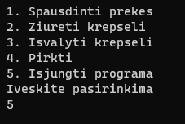
What are methods?
Methods
The call for both methods would be:
And the programme would look like this:

Slide 8
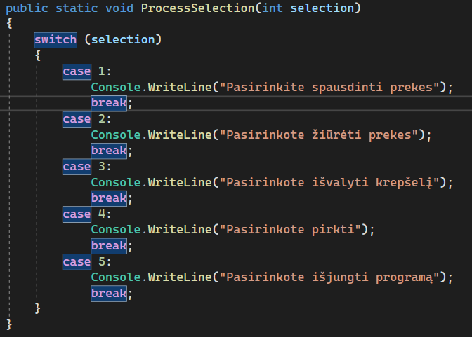
What are methods?
Methods
Now let's look at the method that accepts the parameter.
In the previous method, we got user choice,
we can now use this choice.
The parameter is described between () after the method
name, in this case the parameter is int data
type(parameters can be of any data type)
and its name selection, it is the method of
acts like any other variable in context,
but we must always pass it on by inviting this
method.
This method will not return anything, but can redirect to
further functionality of the software.

Slide 9
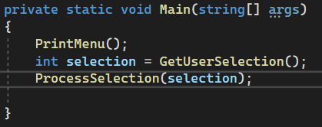
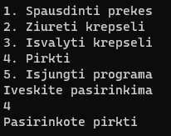
What are methods?
Methods
The call for both methods would be:
And the programme would look like this:

Slide 10
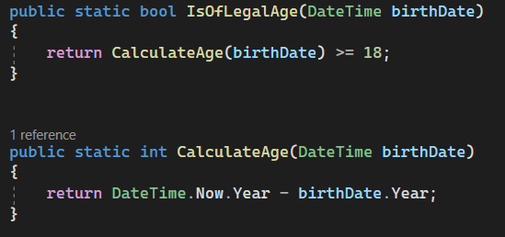
Calling a method from another method
Methods
Here we can see how the call of one method can be utilised from another.
Most often, for a single line of code, we use the method
we won't create, but we can create an example

Slide 11

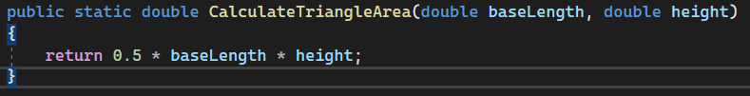
Examples of methods
Methods
A method for calculating the distance between two points in two-dimensional space using the Euclidean space formula.
This method calculates the area of a triangle

Slide 12


Examples of methods
Methods
This method calculates whether the year is a leap year.
This method, with a slightly more complex syntax, checks that the phone number is the correct length and that all characters in the text are digits

Slide 13

Methods
Task 1
Create a method called IsPasswordValid that accepts one parameter of type string (password). The method should return true if the password is longer than 8 characters and false if it is shorter.
Create a method called IsEmailValid that checks if the string type parameter (email) is a valid email address. The method should return true if the email is valid (contains "@" and "."), or false if it is not.
Create a ConvertToEuros method that accepts one parameter of type double (dollars). The method should convert dollars to euros at a fixed rate (e.g. 0.85) and return the euro amount.

Slide 14
Methods
Task 2
Create a GetInitials method that accepts two parameters of type string (firstName and lastName). The method should return the first and last name in one sentence.
Create a method CalculateCylinderVolume that accepts two parameters of type double (radius and height). The method should calculate and return the volume of the cylinder.
Create an IsNumberEven method that accepts one parameter of type int (number). The method should return true if the number is even, and false if odd.
Create a method CalculateRectangleArea that accepts two parameters of type double (length and width). The method should calculate and return the area of the rectangle.

Slide 15
Recursion
Methods
Recursion is a computer science concept where a function or method calls itself in its definition. In simple terms, it is when a function solves a problem using the same problem but on a smaller scale until it reaches a case where the answer is obvious and can be directly returned.

Slide 16
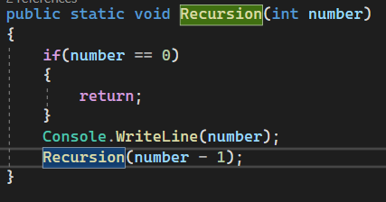
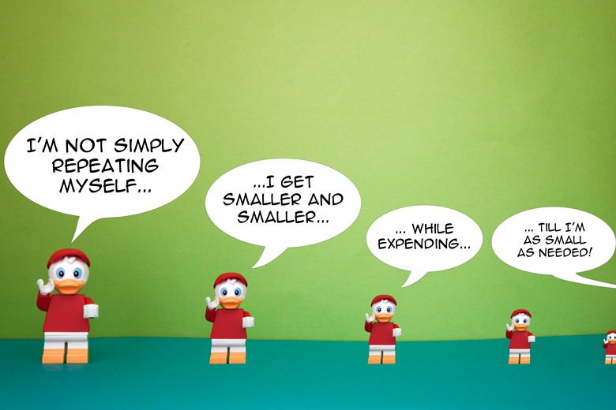
Recursion
Methods
Here we see an example of recursion, first checking
whether the number entered is non-zero, if zero return
zero, but if non-zero, the same method is called
with only one less parameter.

Slide 17

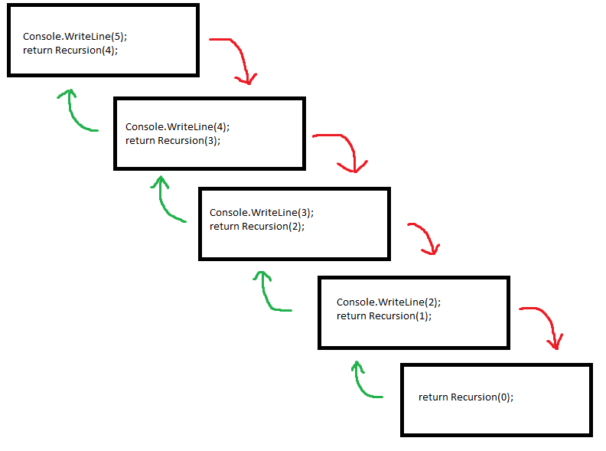

Recursion
Methods
We call this recursion method:
Its operation will look like this:
And the output will be as follows

Slide 18
Methods
Task 3
Using recursion, create a program to calculate the Factorial.
Using recursion, create a Fibonnaci calculation program.

